Slide 1
Gabriel Galeote Checa
Project Bioimplantable Device for Optogenetics Techniques | What I did last four weeks? Test circuit Order and test substrates Design antenna
Problem being faced? Soldering techniques (Flip-chip and wire bonding) Antenna design and tunning | What to do in next two weeks? Finish circuit prototype Test different substrates Test different antennas

Slide 2
Bioimplantable Device
1. Problems found
Soldering techniques: Wire-bonding and flip chip → Increases the manufacturing time so far
Problems found
Propagation Distance?
Configuration of the antenna
Antenna Gain?
How to reduce size?
Voltera machine: many problems with ink, cleaning of needles, weakness of needles…

Slide 3
Bioimplantable Device
Current work
My Plan
Circuit
Antenna
Is the circuit working for 13.56 MHz?
Which amplitude do we need?
Can we order the soldering of the circuit with 0204 even les sized components?
Are the primary and secondary coil working for 13.56 MHz?
Which is the power transmitted?
Which shape and antena configuration should we choose?
Next Step

Slide 4
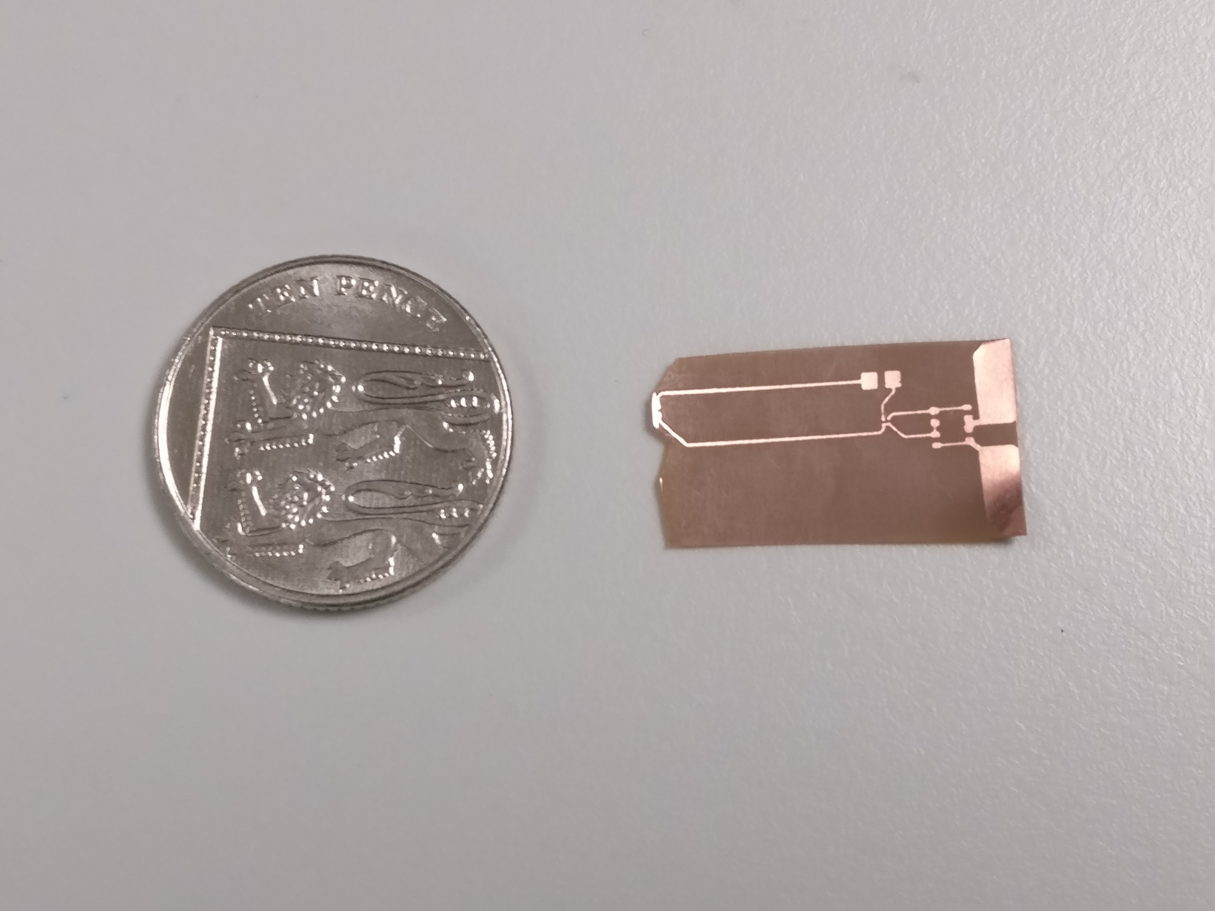
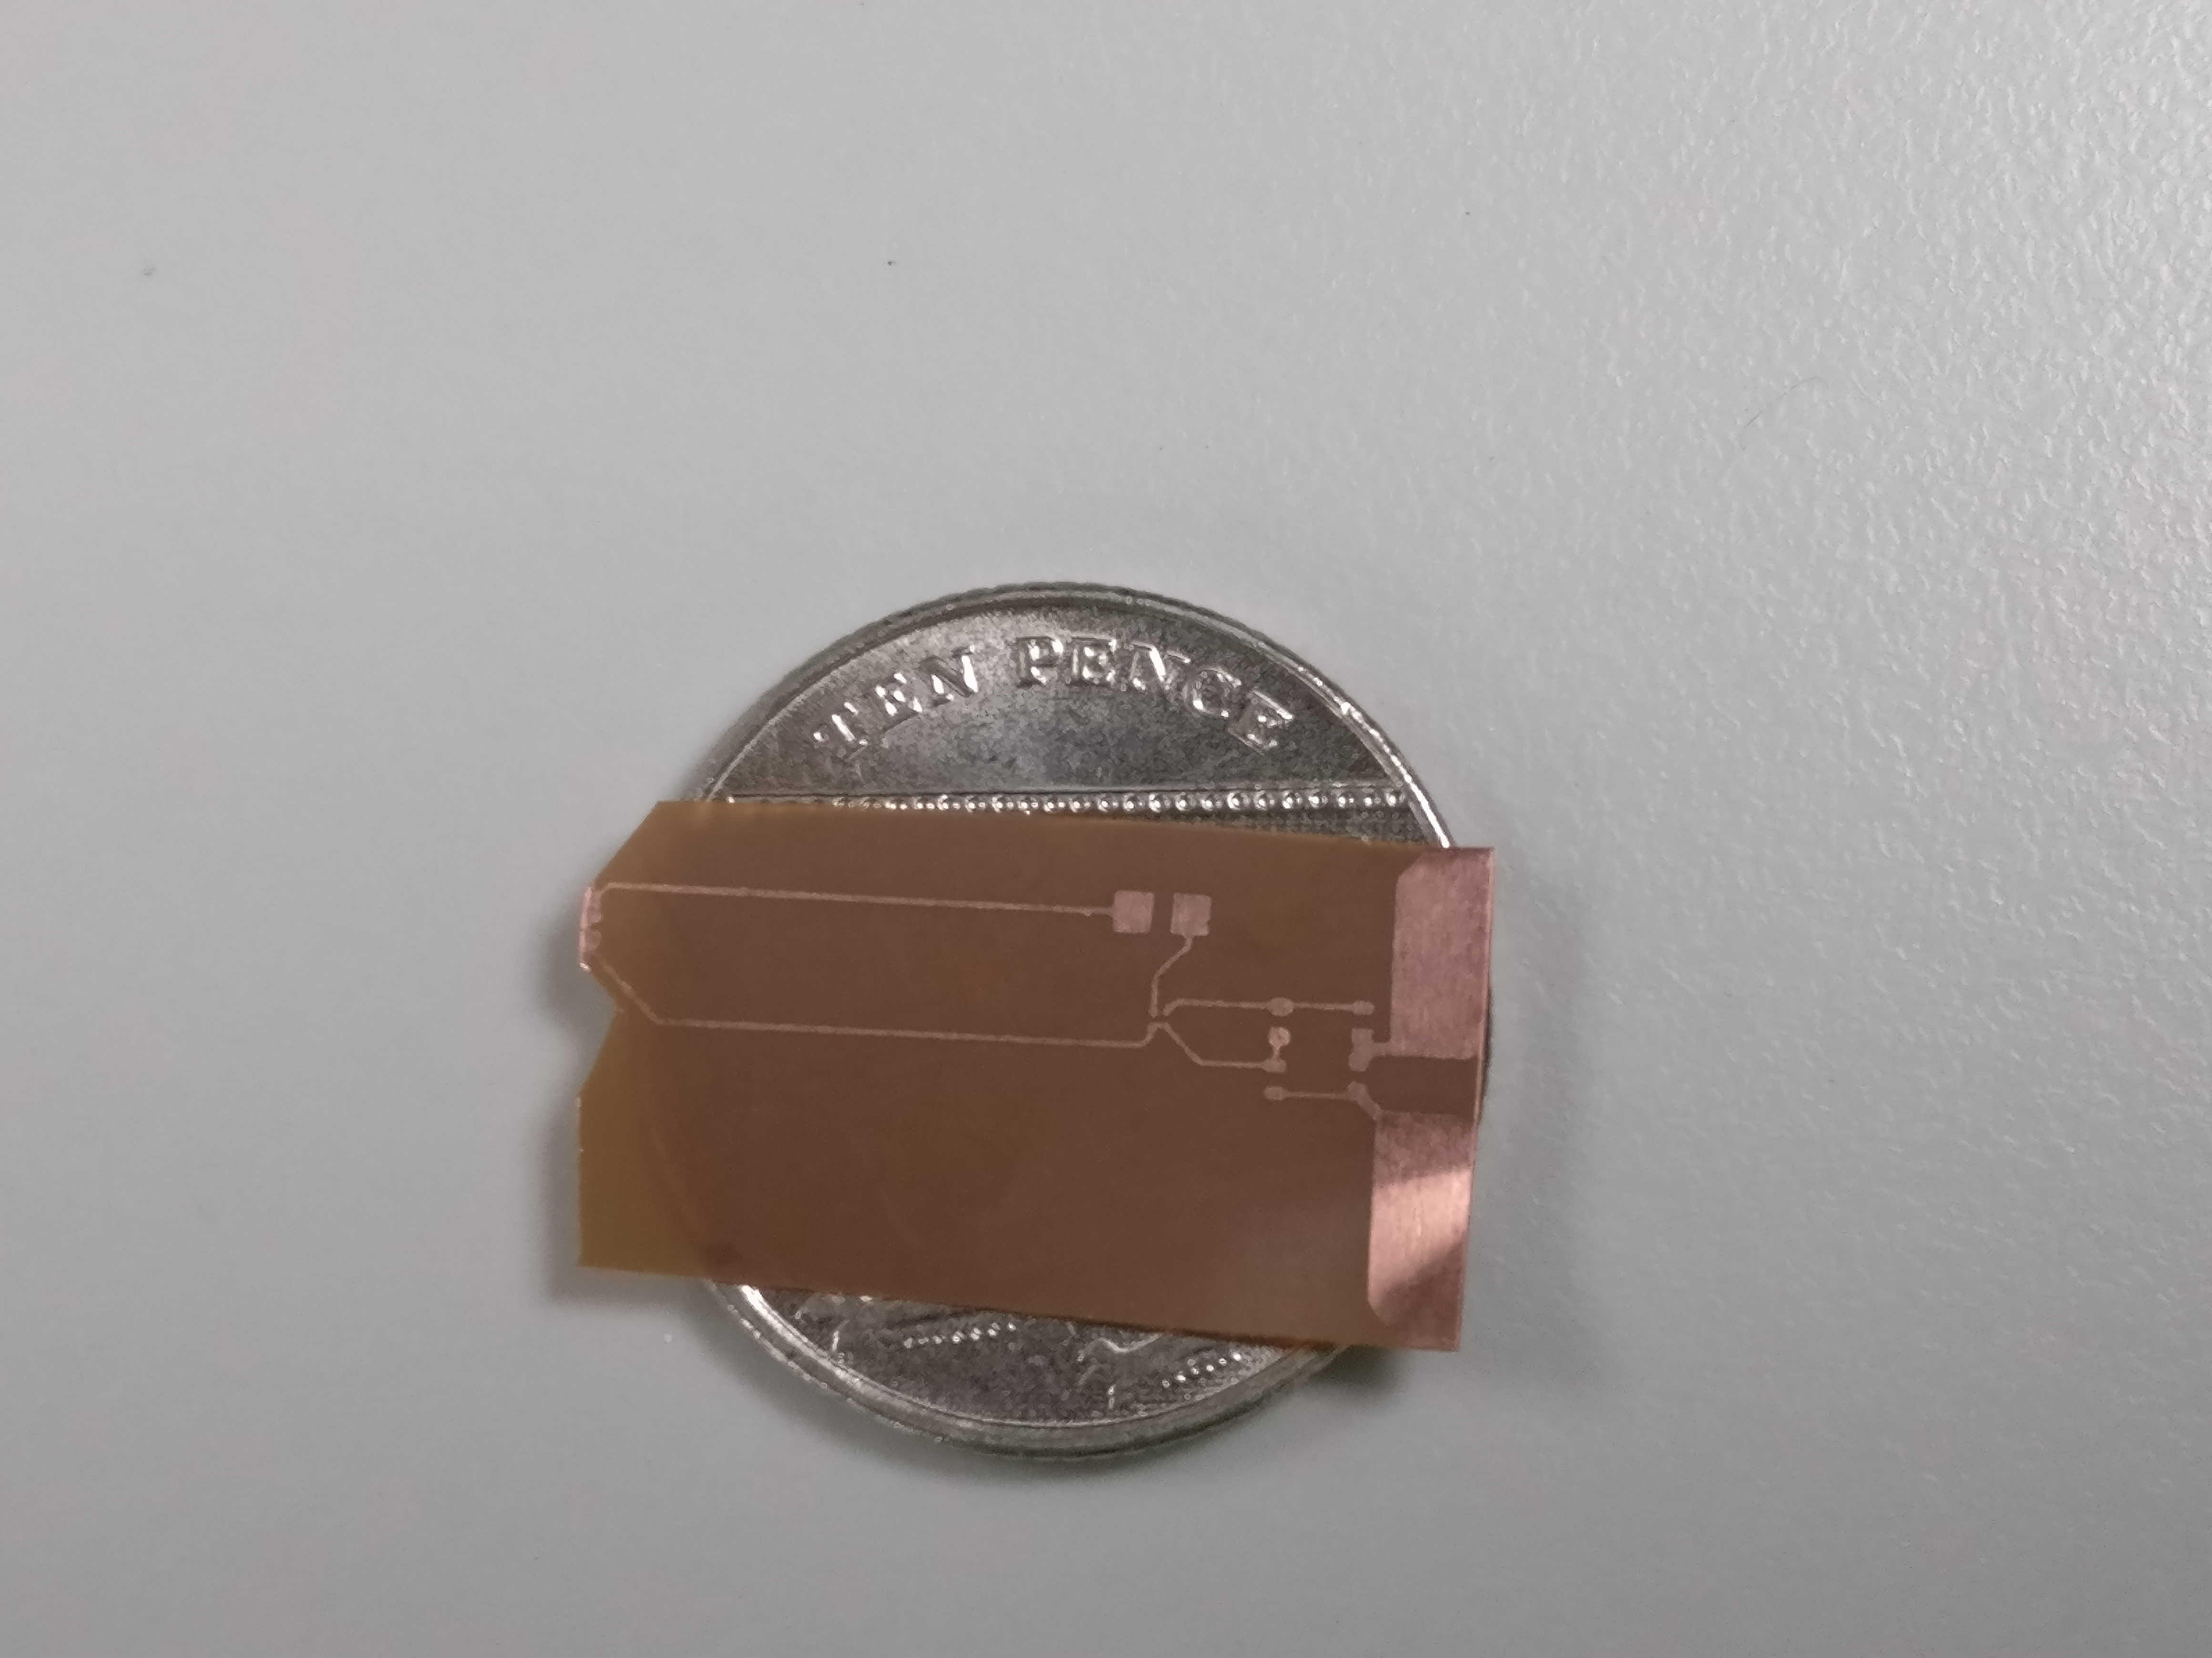
Bioimplantable Device
Approximate final circuit size

Slide 5
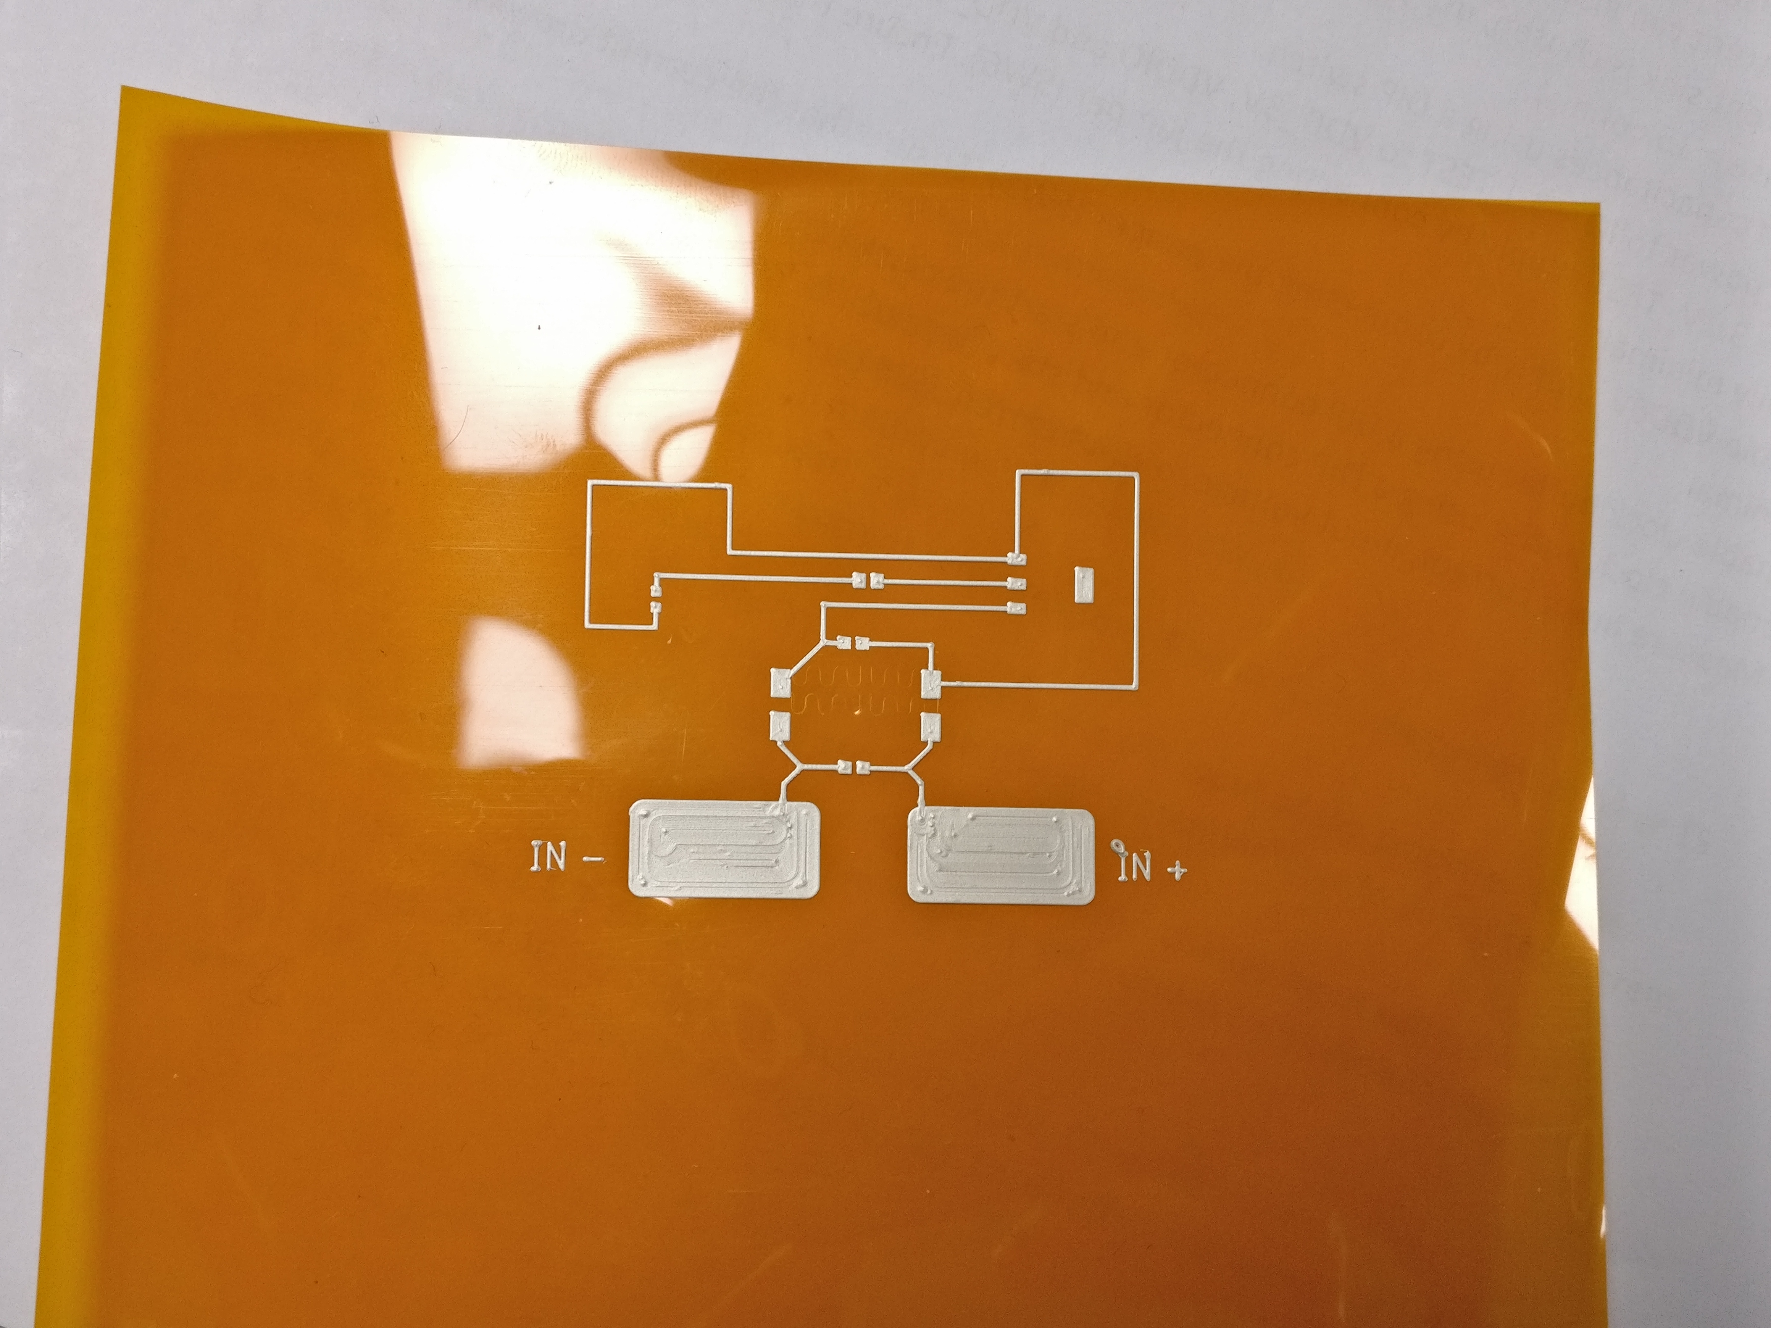
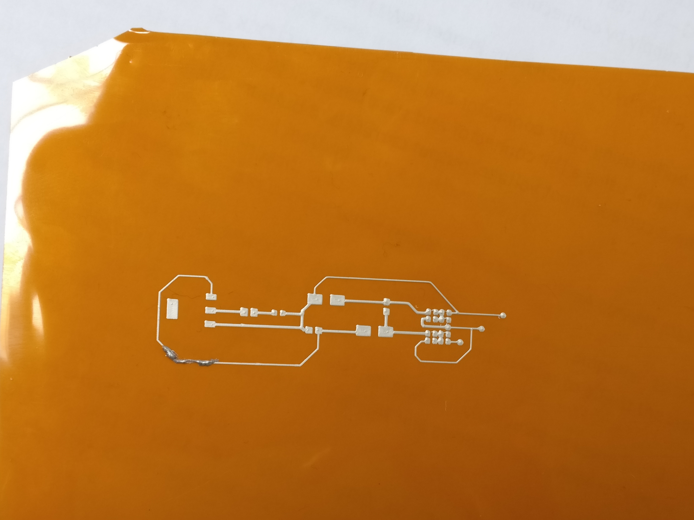
Bioimplantable Device
Circuit printed in polyimide

Slide 6
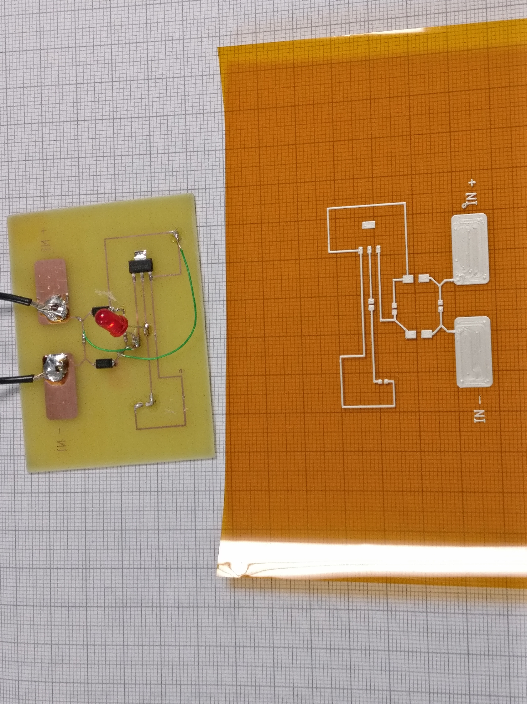
Bioimplantable Device
Comparison between boards

Slide 7
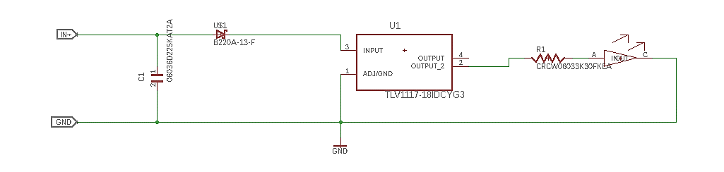
Bioimplantable Device
Final Circuit design
Improvements?

